Slide 1

UE19CS204 – Web Technologies Mini Project
Project Title – Appointment Scheduler
Section - A
Aishwarya Harinivas – PES2UG19CS019
Anusha M – PES2UG19CS054
GITHUB Link -

Slide 2
Abstract
The project is an appointment scheduler that allows you to book an appointment for consultation at a hospital.
The application has 2 pages: a home page and a schedule page, which were created using ReactJS
The schedule page collects data from the patient and stores it in a database using NodeJS, ExpressJS and MongoDB

Slide 3





Technologies Used
React JS
Node JS
Express JS
MongoDB
Material UI

Slide 4
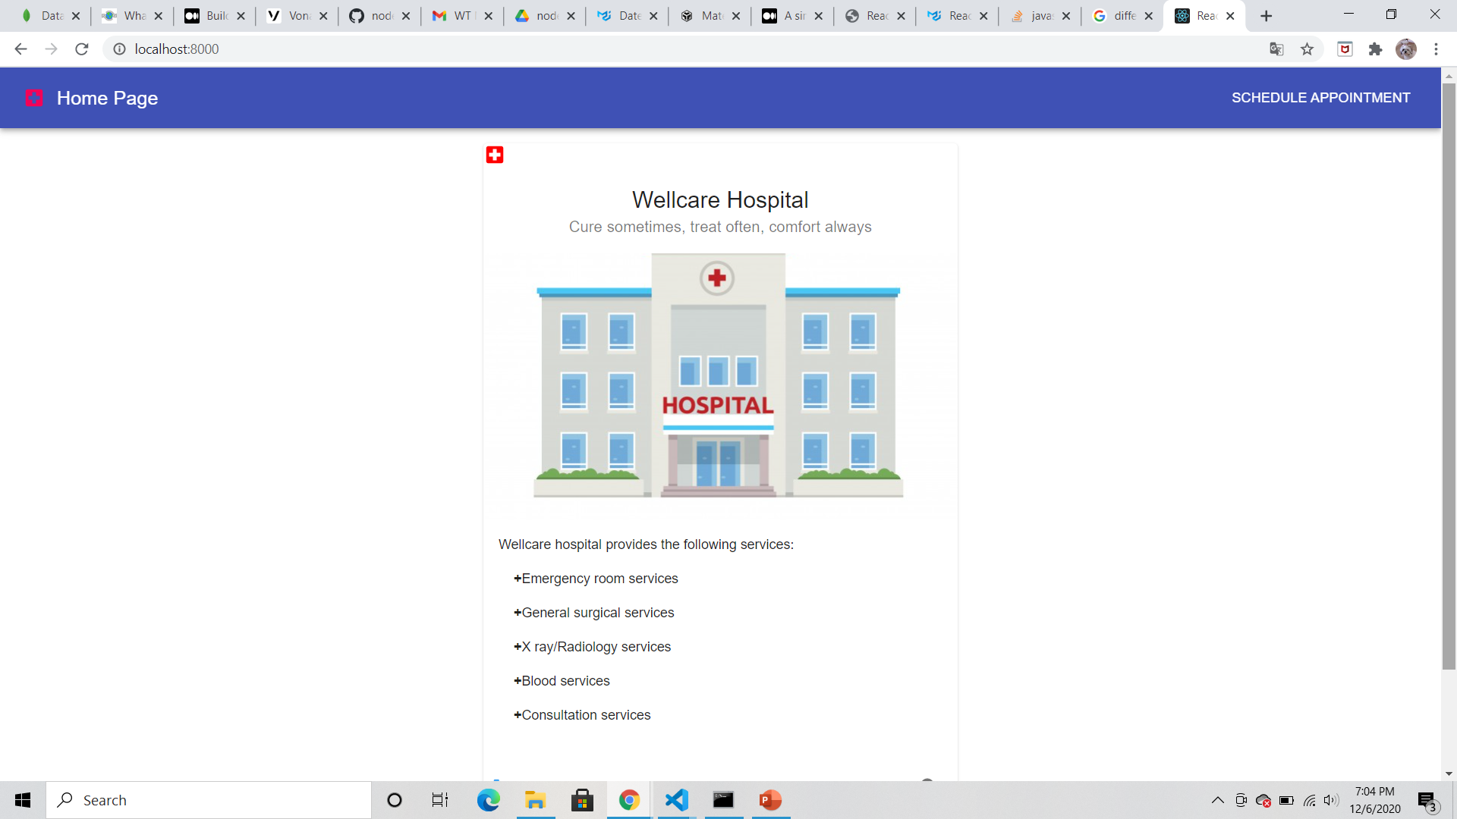
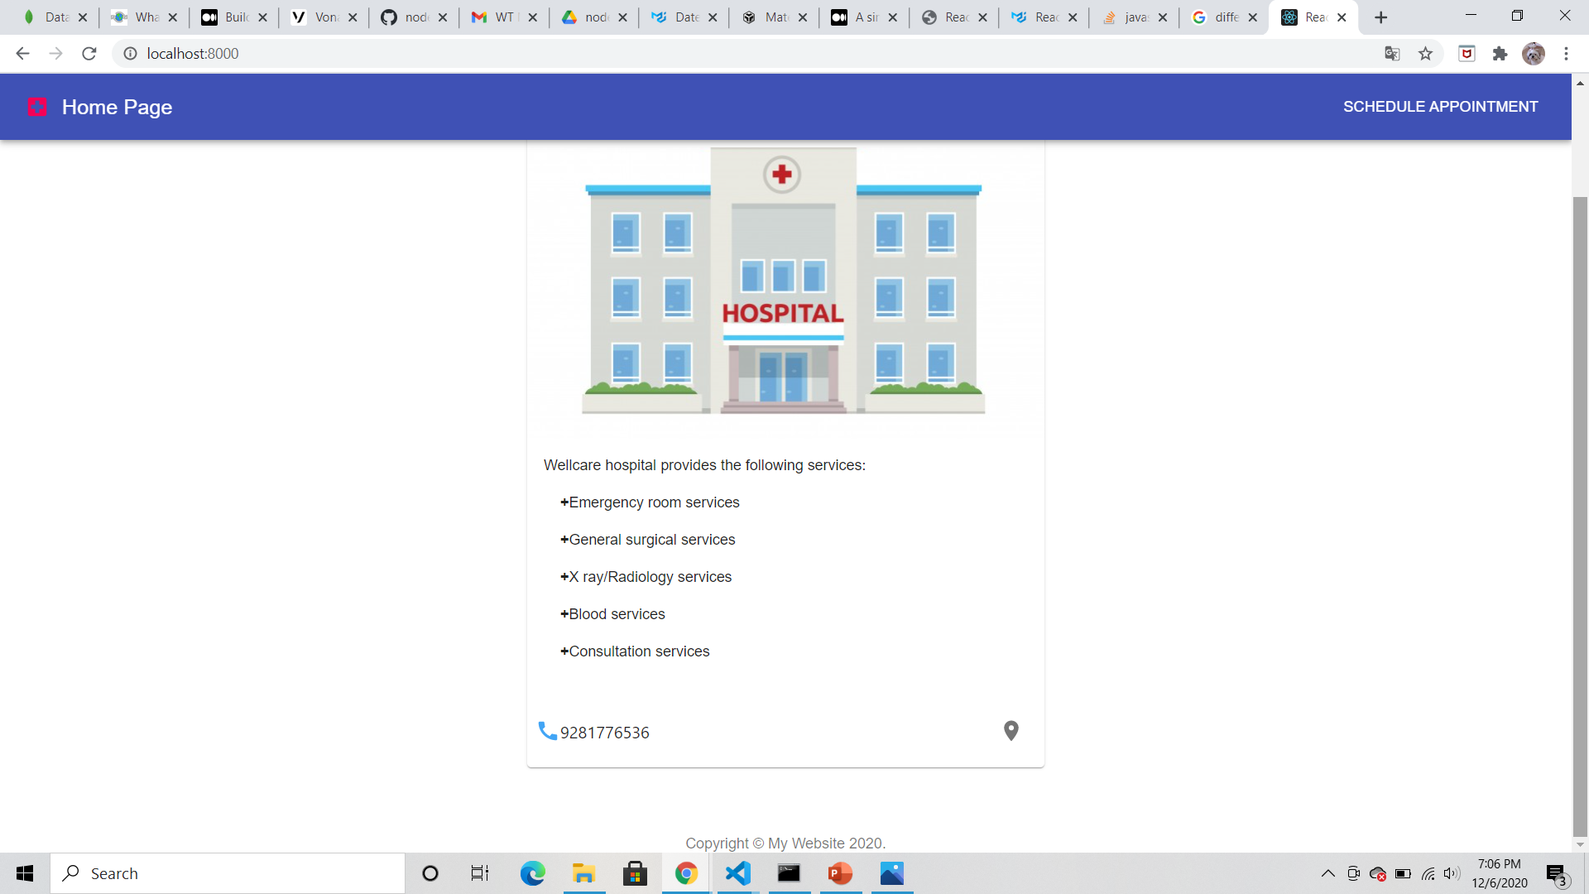
Front-End

Slide 5
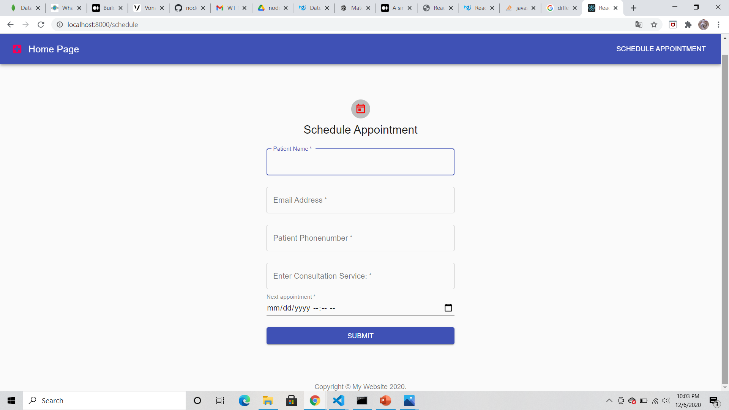

Slide 6
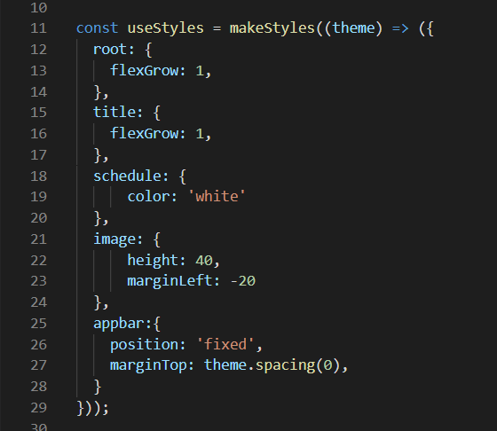
Appbar
The appbar consists of an icon, a link to the homepage, and a button that routes you to the appointment scheduling page.
makeStyles() method allows you to define styles for various components.
These styles can be later accessed by the useStyle() method.
appheader.js

Slide 7
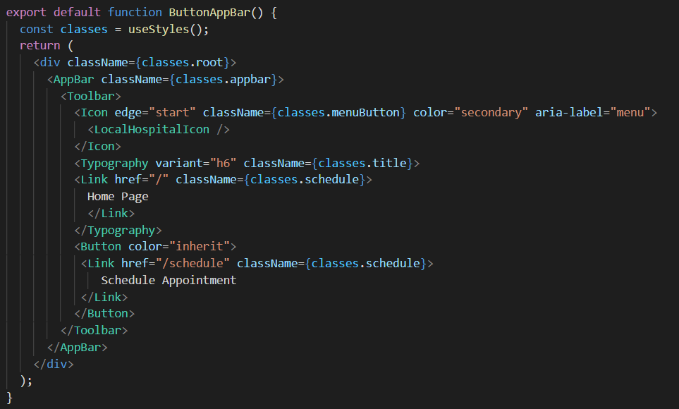
We have made use of material UI components to simplify the code
The Appbar component is used to create the appbar
The Toolbar component displays the children of the appbar
The Typography component standardizes the text to have the same styling
The Link component allows you to route the page, in this case it routes to the home page
The Button component has been used to link to the appointment scheduling page

Slide 8
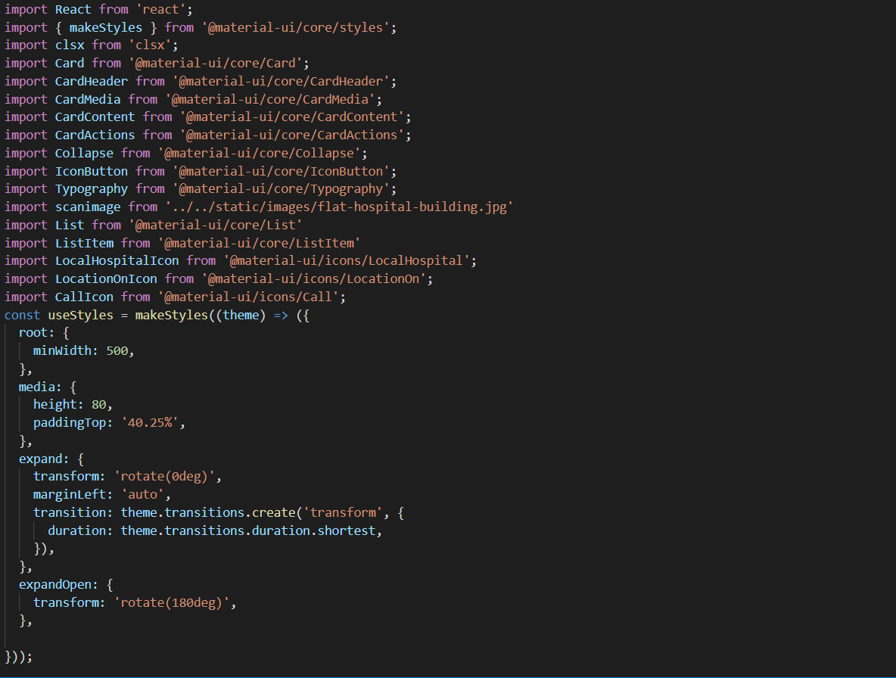
Body of Home Page
homebody.js

Slide 9
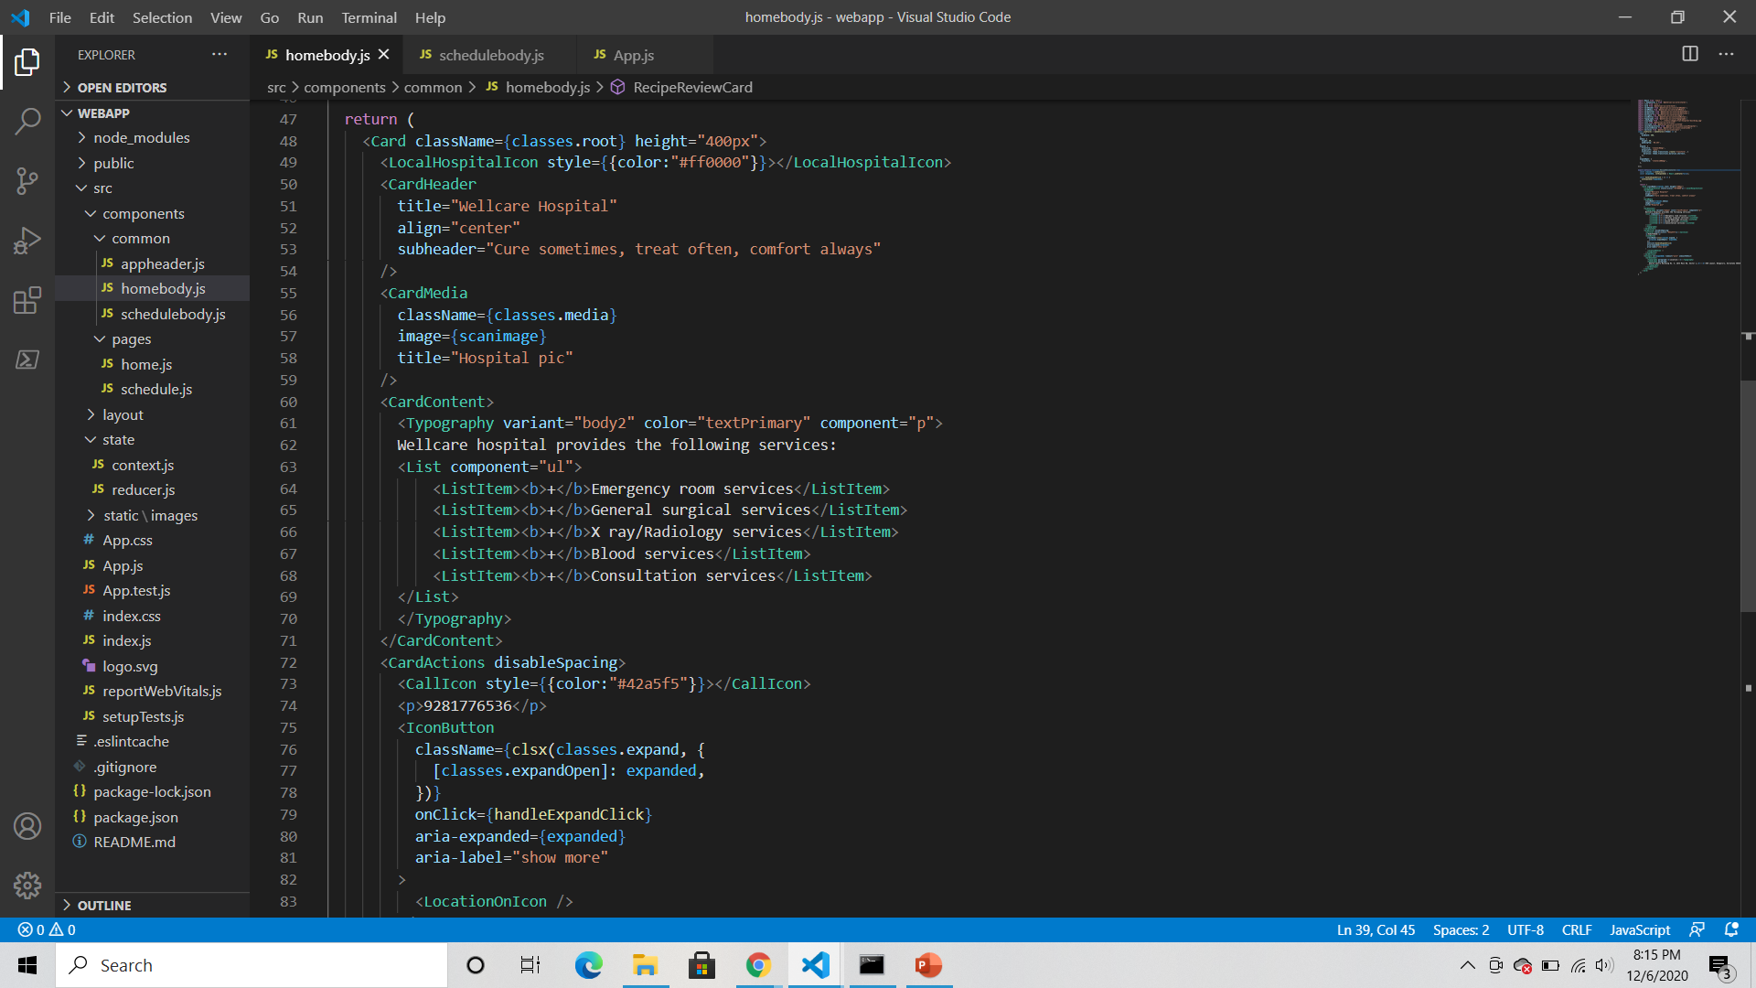
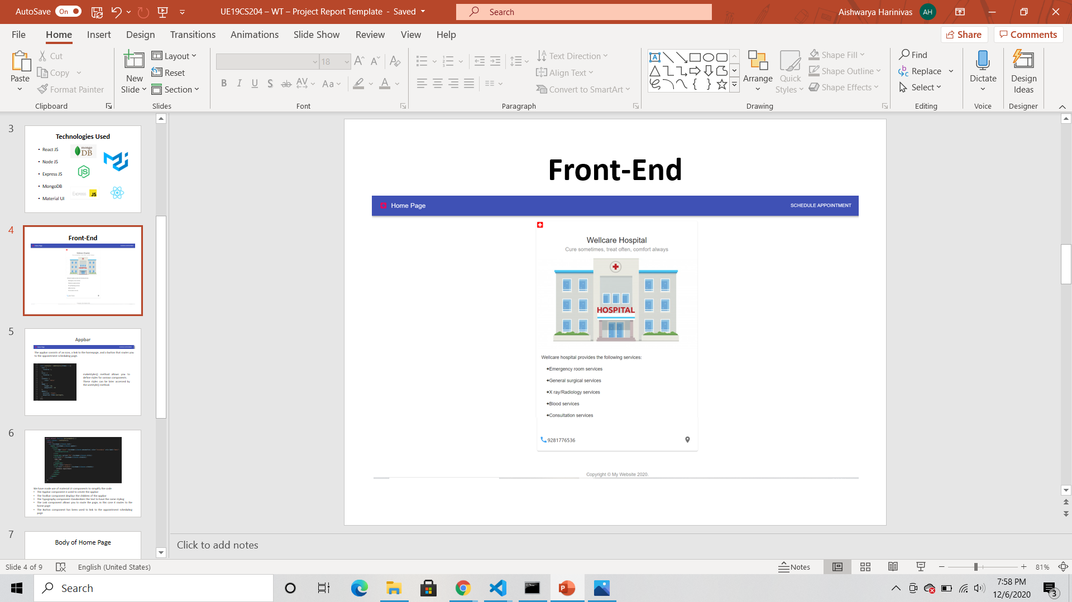

Slide 10
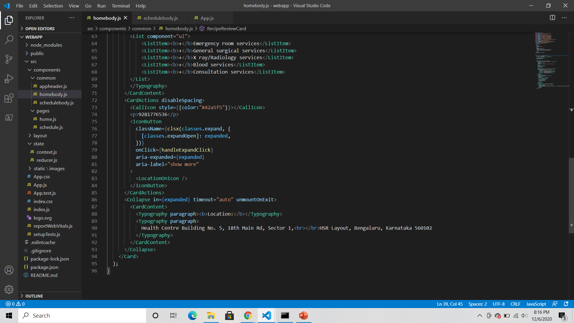
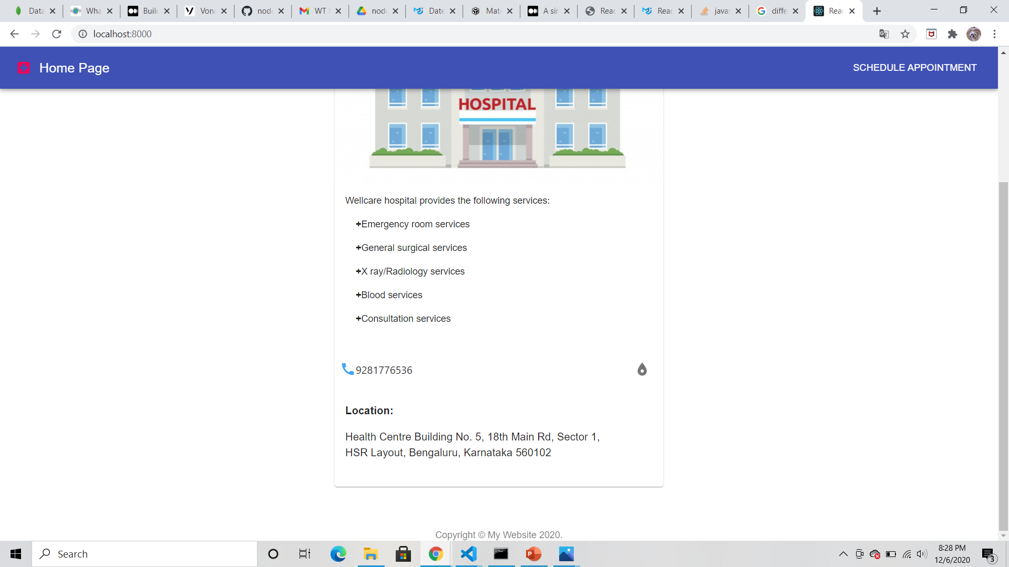
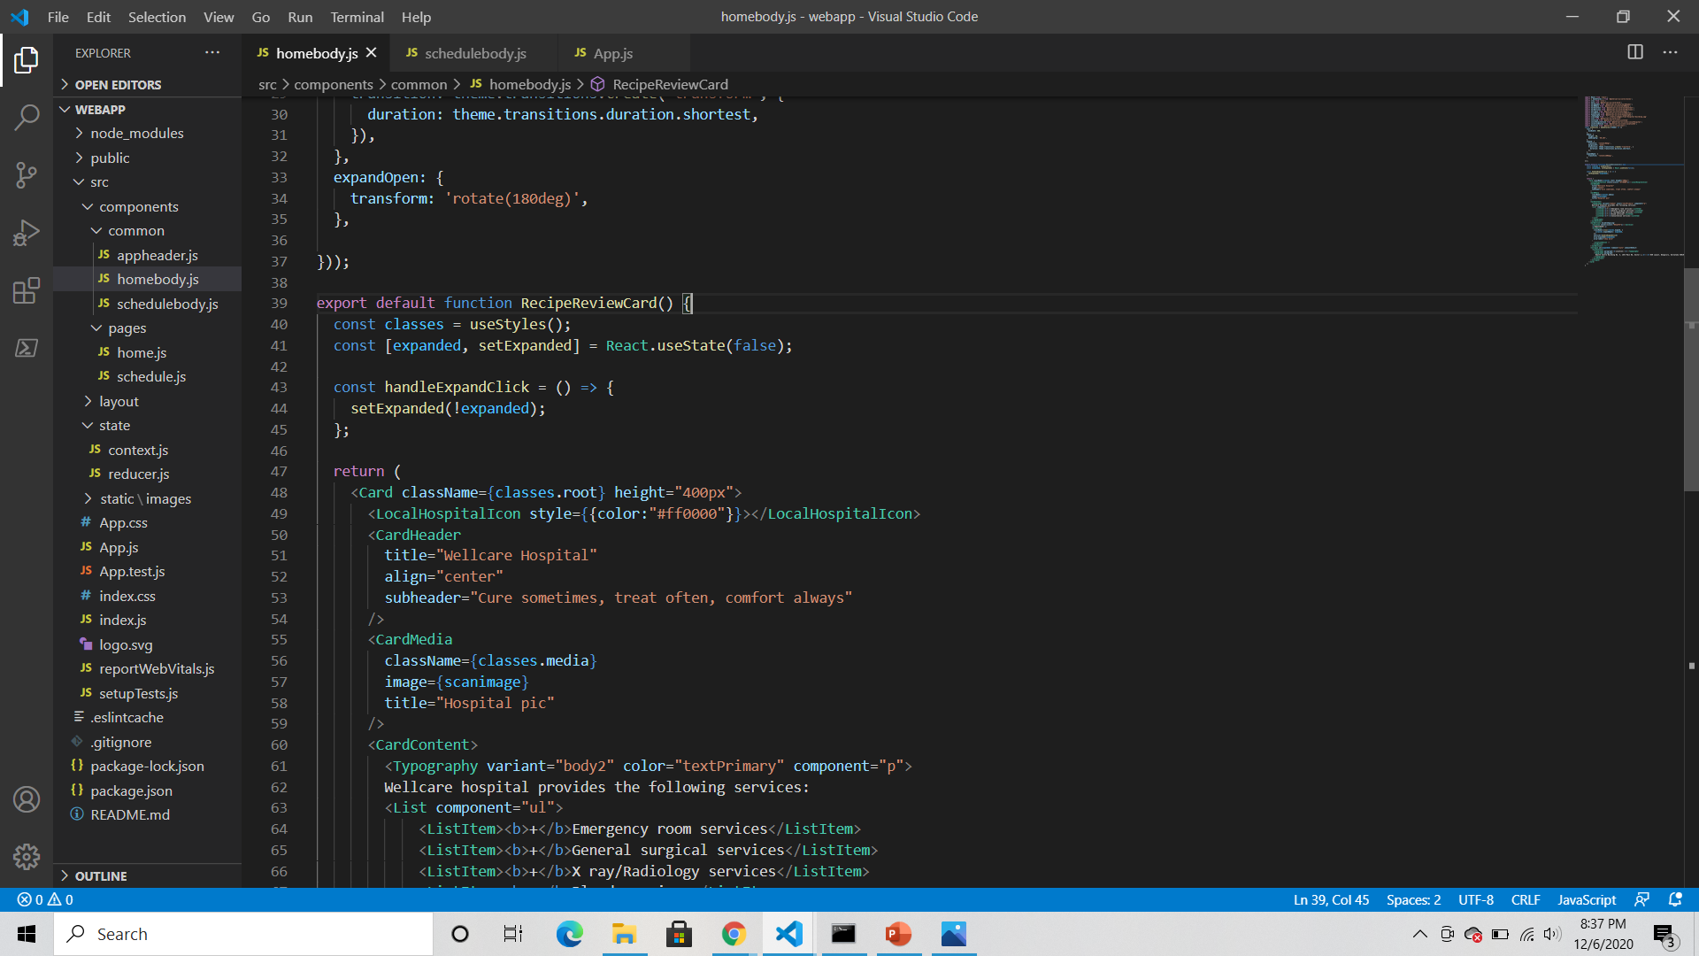
useState() returns a tuple where the first parameter, expanded, is the current state of expand in this case and the second parameter, setExpanded, is used to update the state of expanded from anywhere

Slide 11
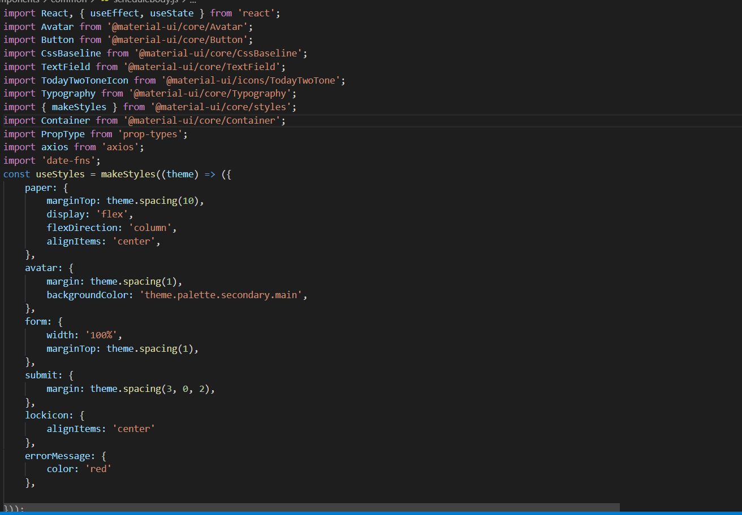
Body of Appointment Page
schedulebody.js

Slide 12
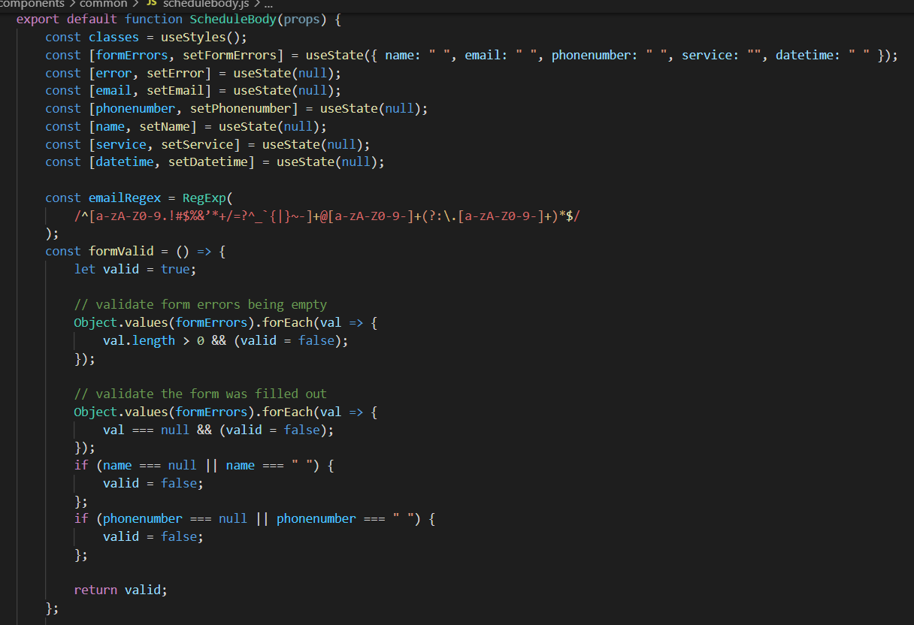
Validation
A regex is used to validate the email id
We first check if the form has any errors
Then, we check if the form has been filled out

Slide 13
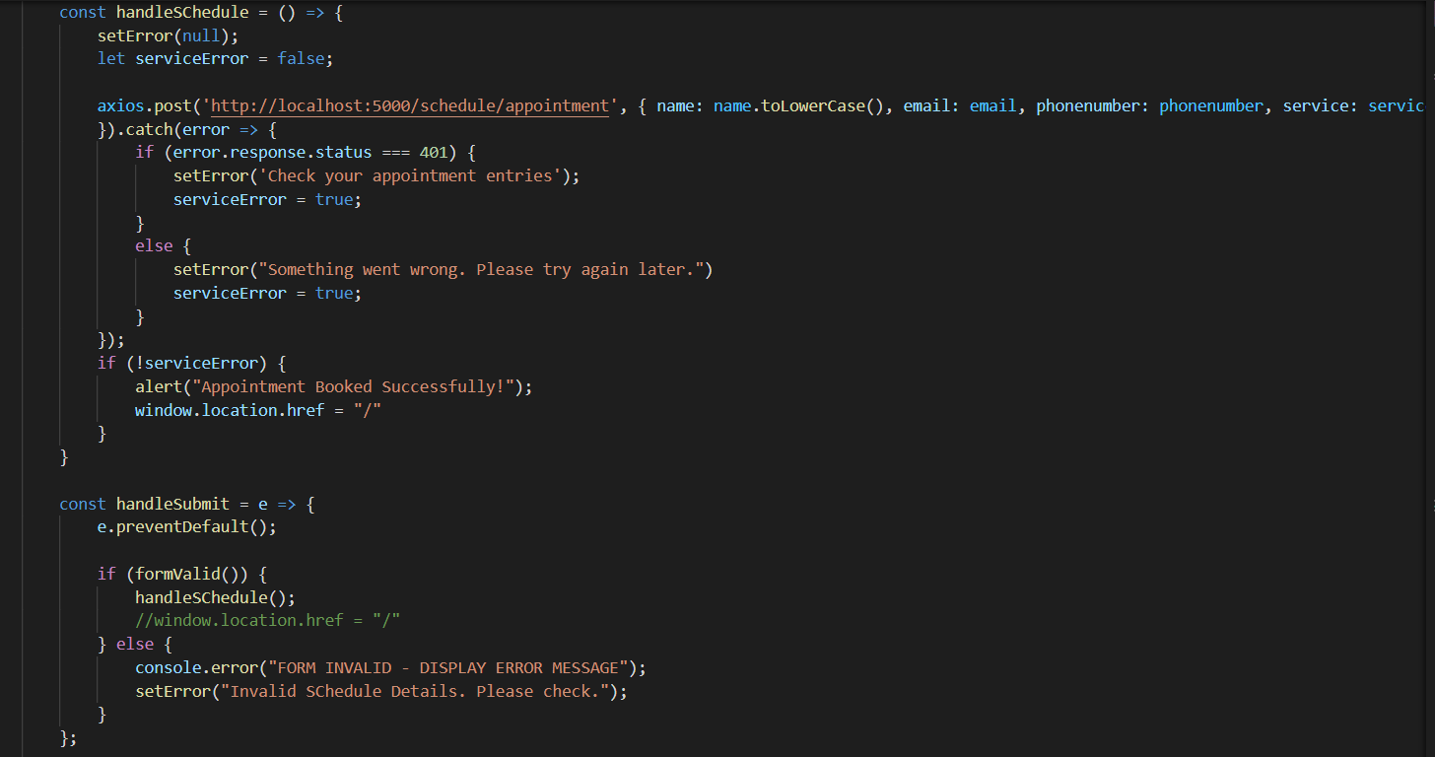
Error Handling
setError() applies the given error message to the selected fields
A post request can be made using Axios to post data to an endpoint
e.preventDefault() cancels the default action that belongs to the event. For ex: On clicking a “submit” button, it prevents the submission of the data

Slide 14
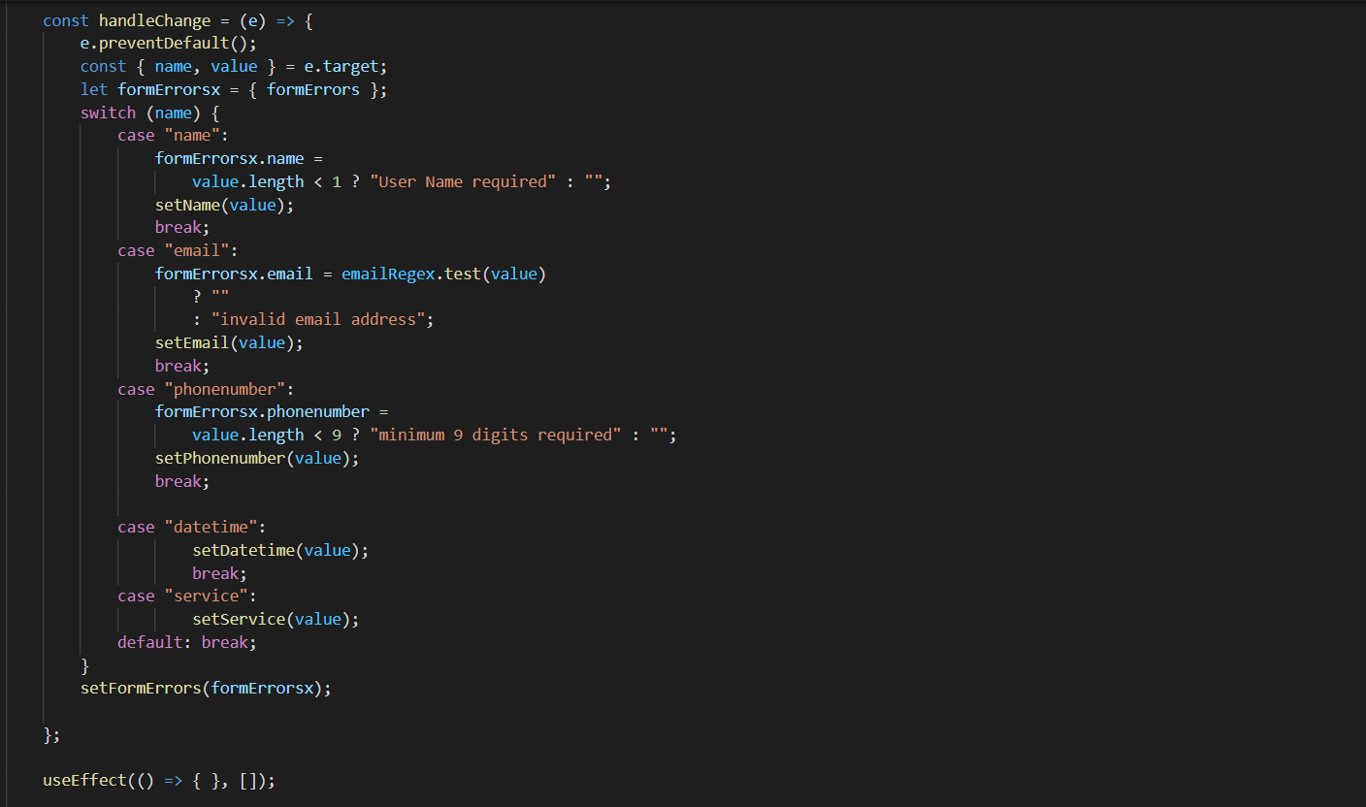
The switch cases check the data as it is entered and set the value of the variables
useEffect() tells React that the component needs to do something after render

Slide 15
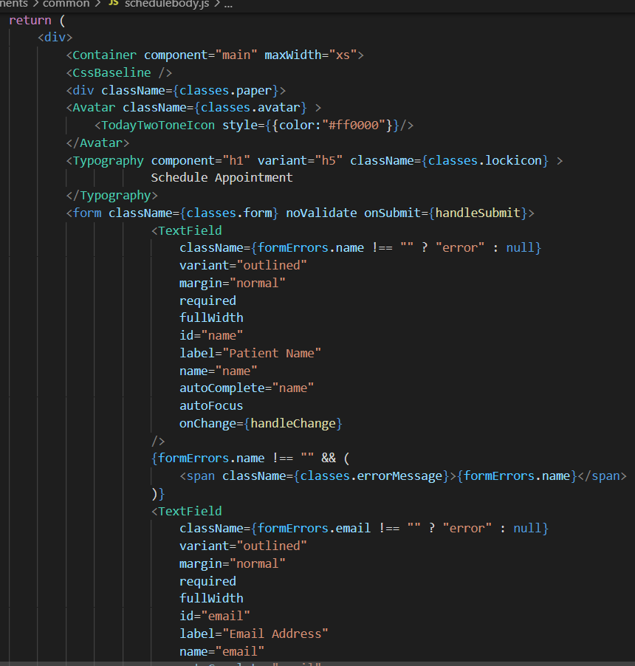
CssBaseline creates a consistent baseline to build upon
We have used Avatar to create an icon avatar which gives the icon a circular outline
We now take input from the user by making use of a form, and check the input as it is being entered for errors

Slide 16
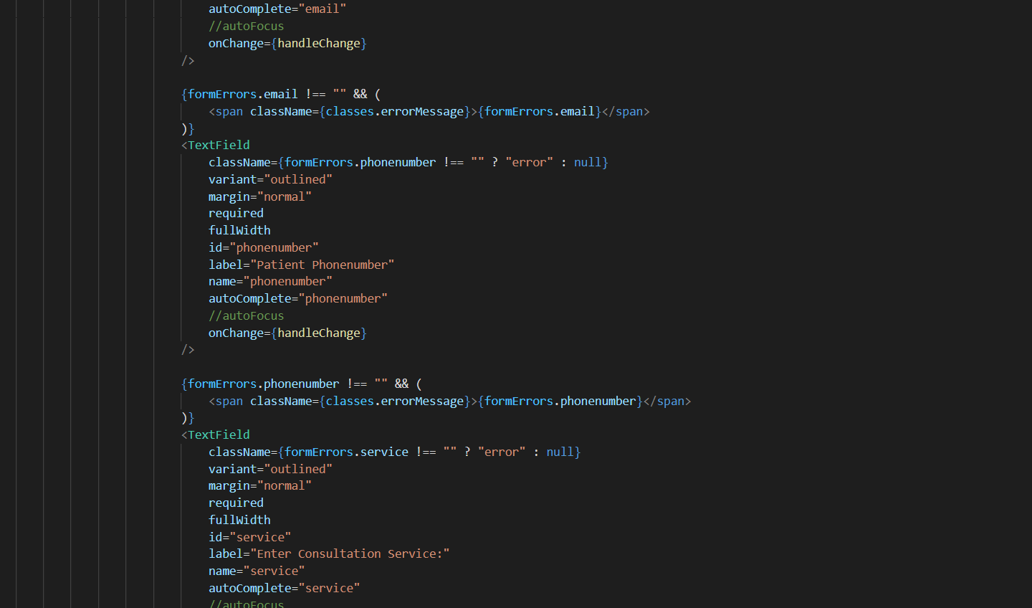

Slide 17
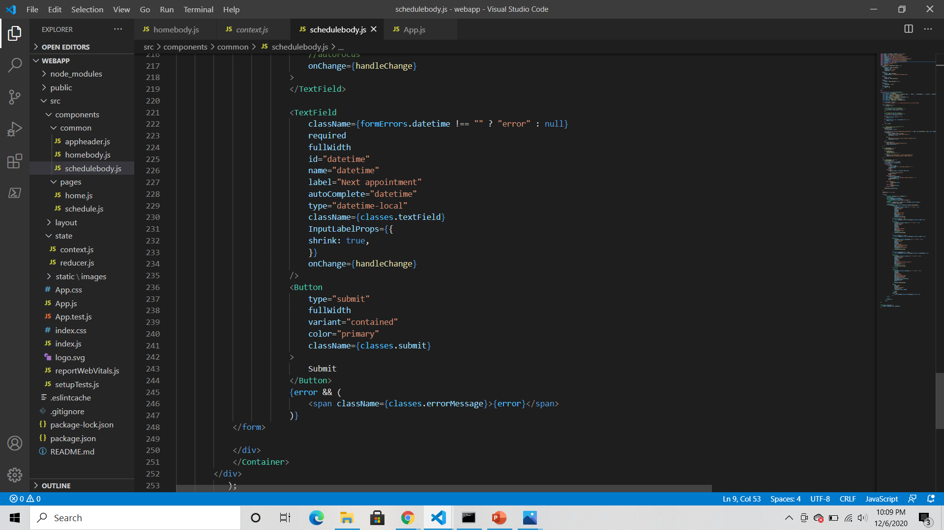
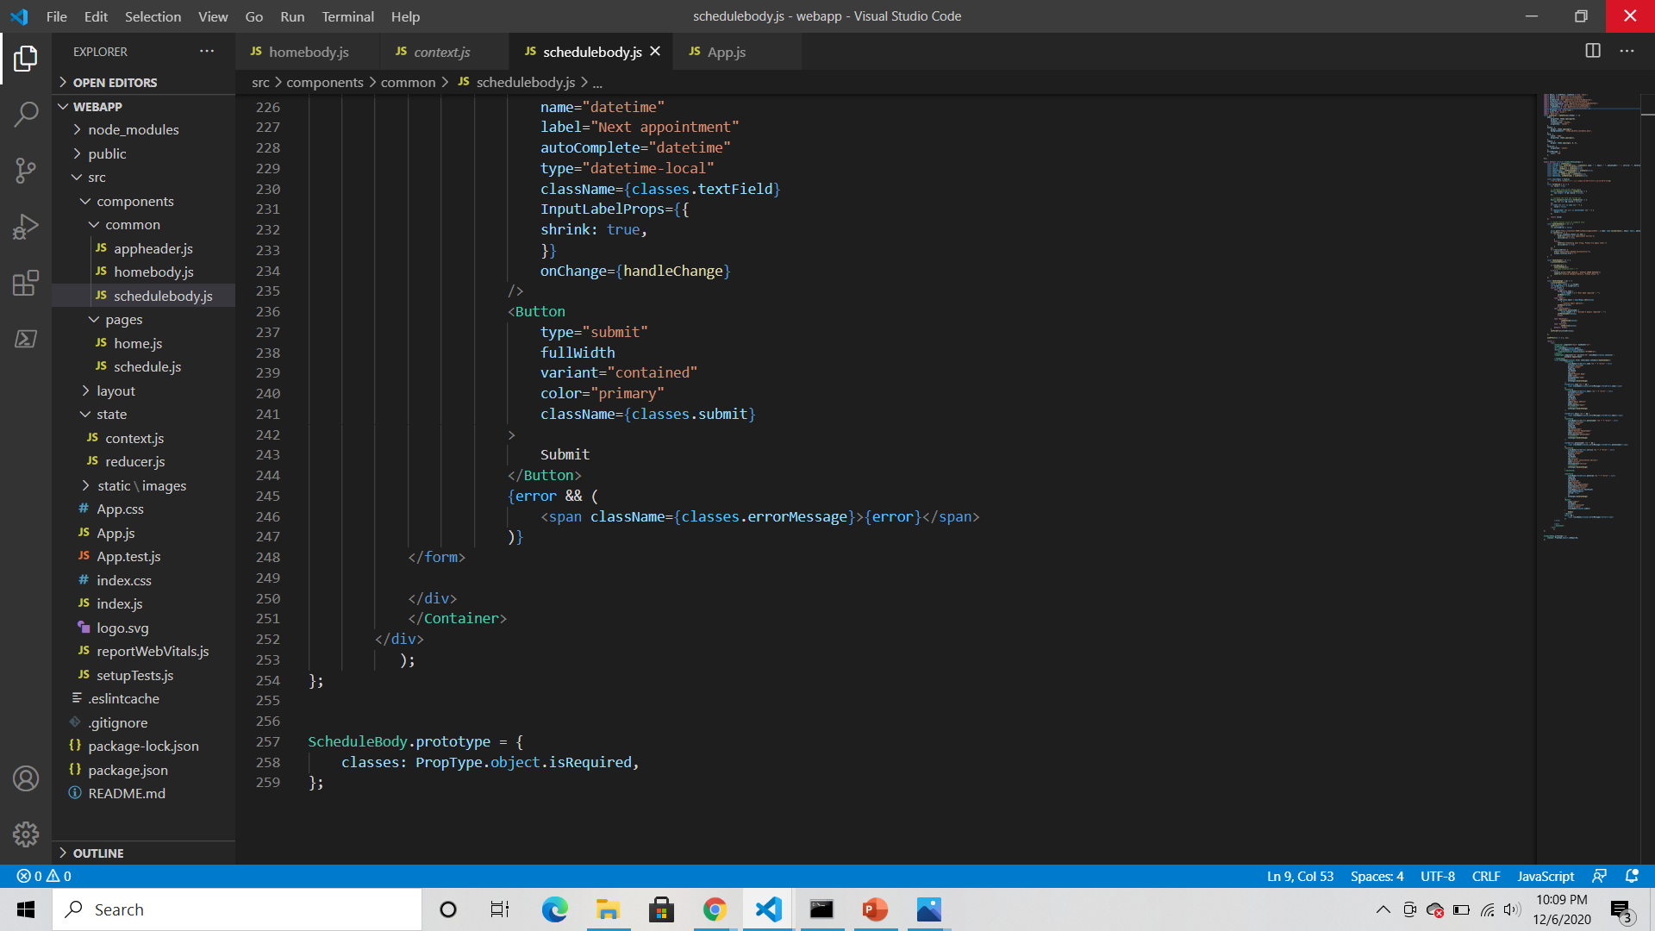

Slide 18
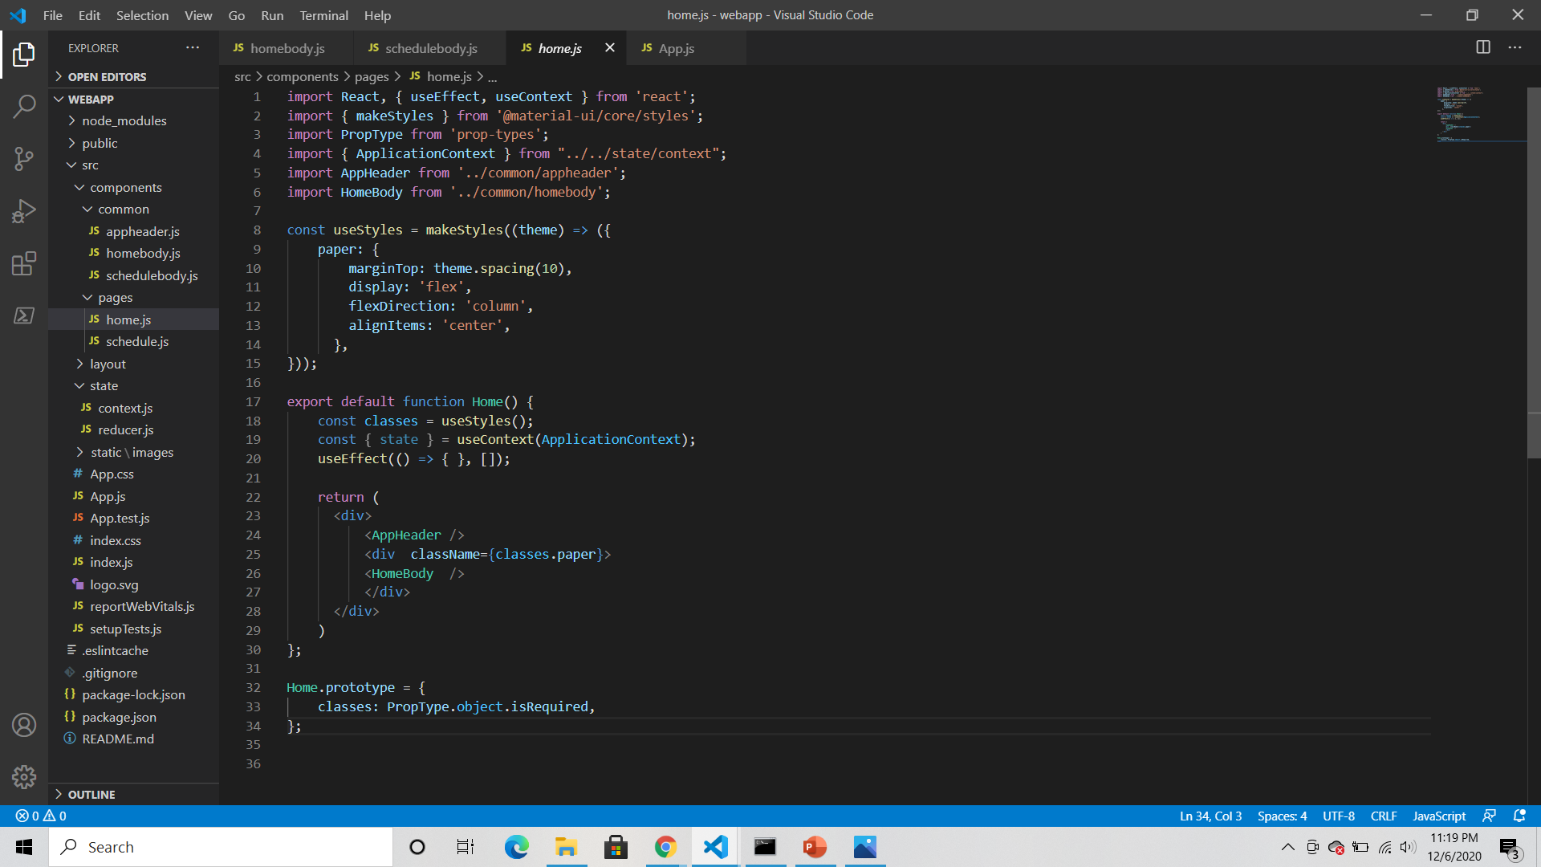
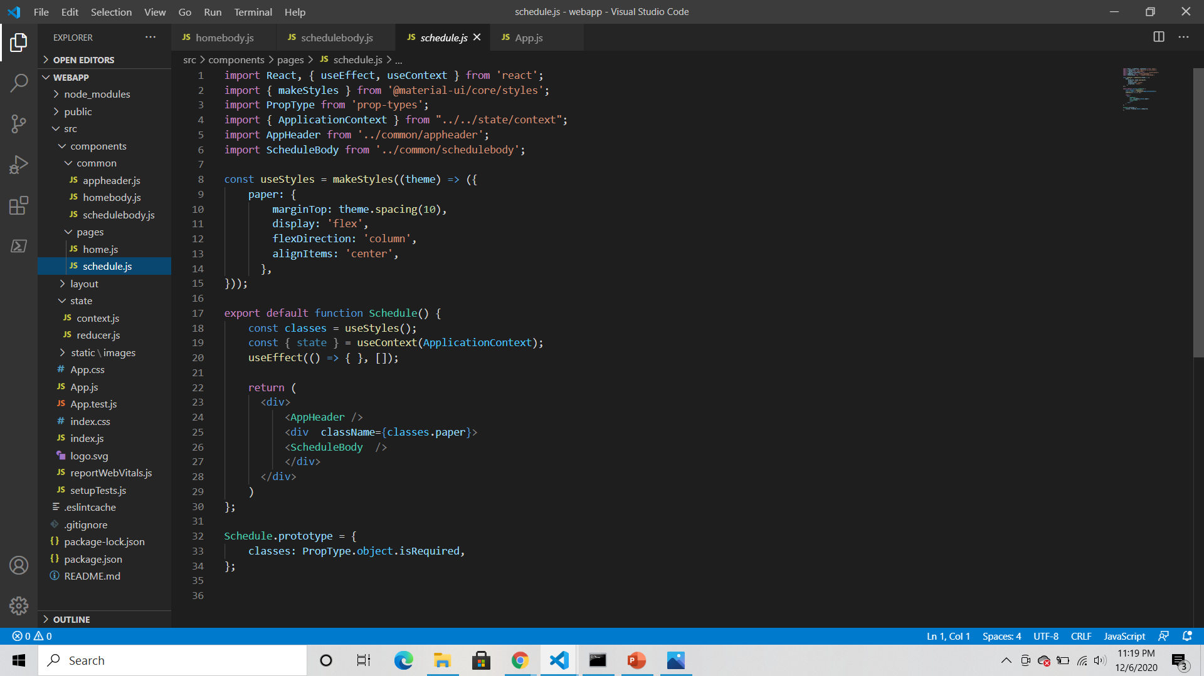
Home page code: (home.js)
Appointment page code: (schedule.js)

Slide 19
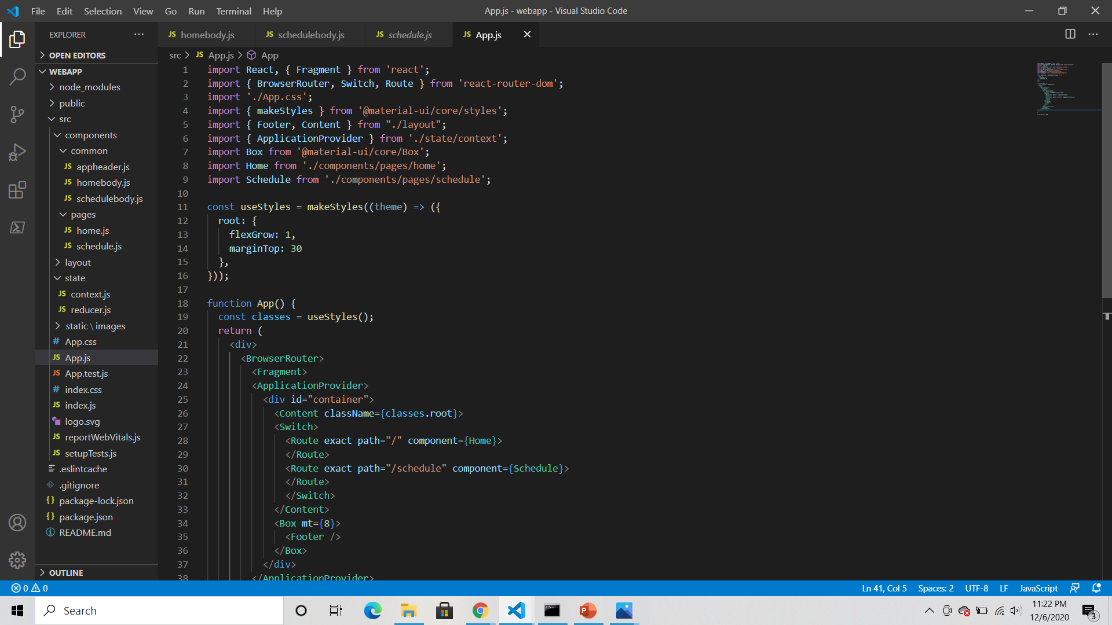
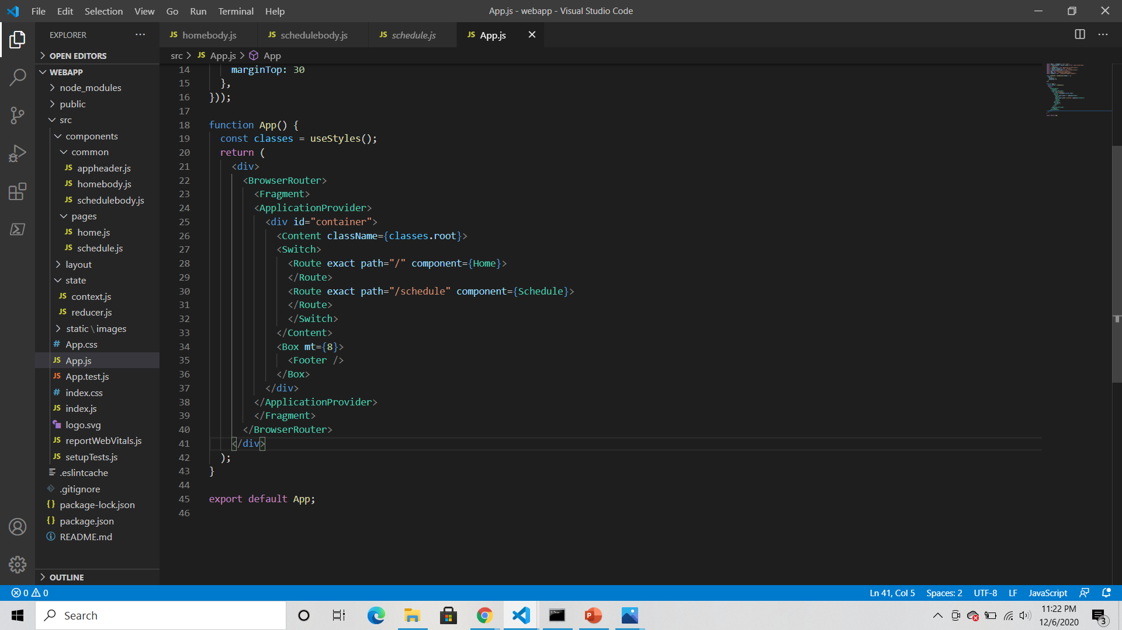
App.js
(router file)
Notes:
BrowserRouter is a Router that keeps the UI in sync with the URL
Fragment helps in returning multiple elements from a component

Slide 20
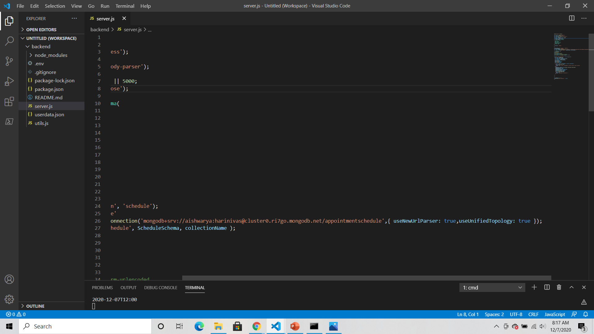
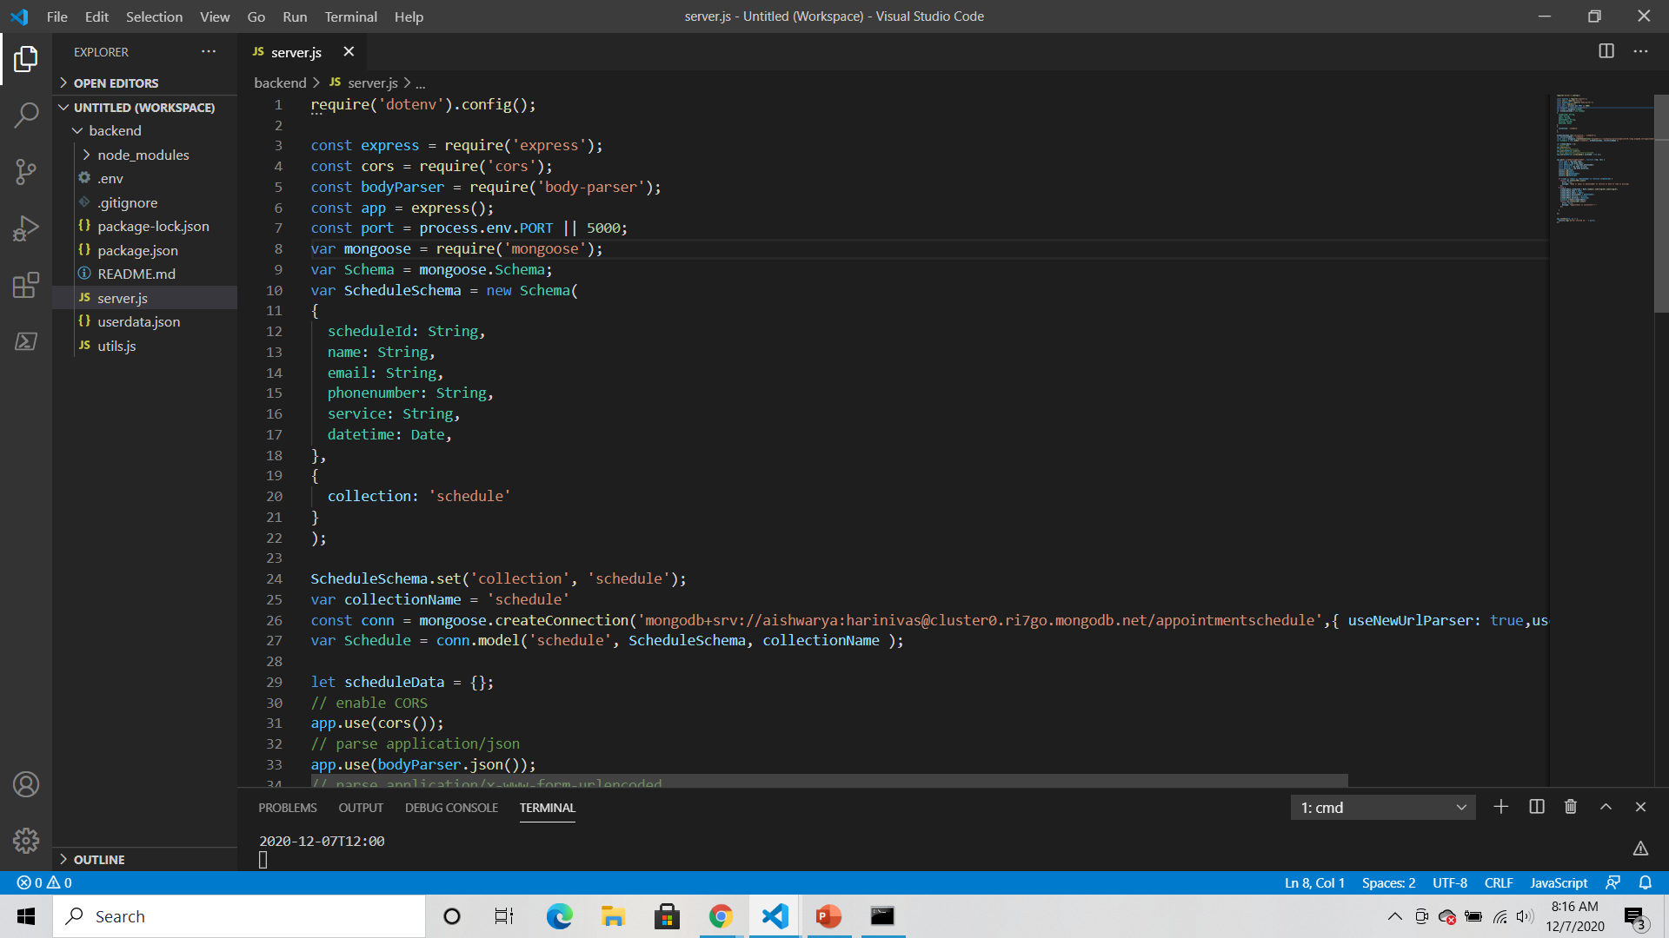
Back-end
We use mongoose to create schemas and models
We also use mongoose to connect to MongoDB Atlas
Notes:
CORS allows or restricts requested resources on web server

Slide 21
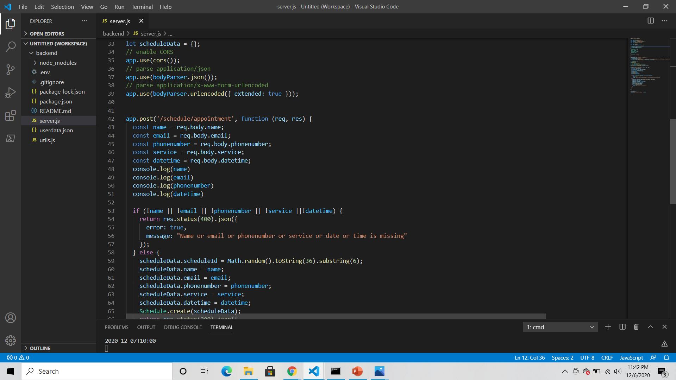
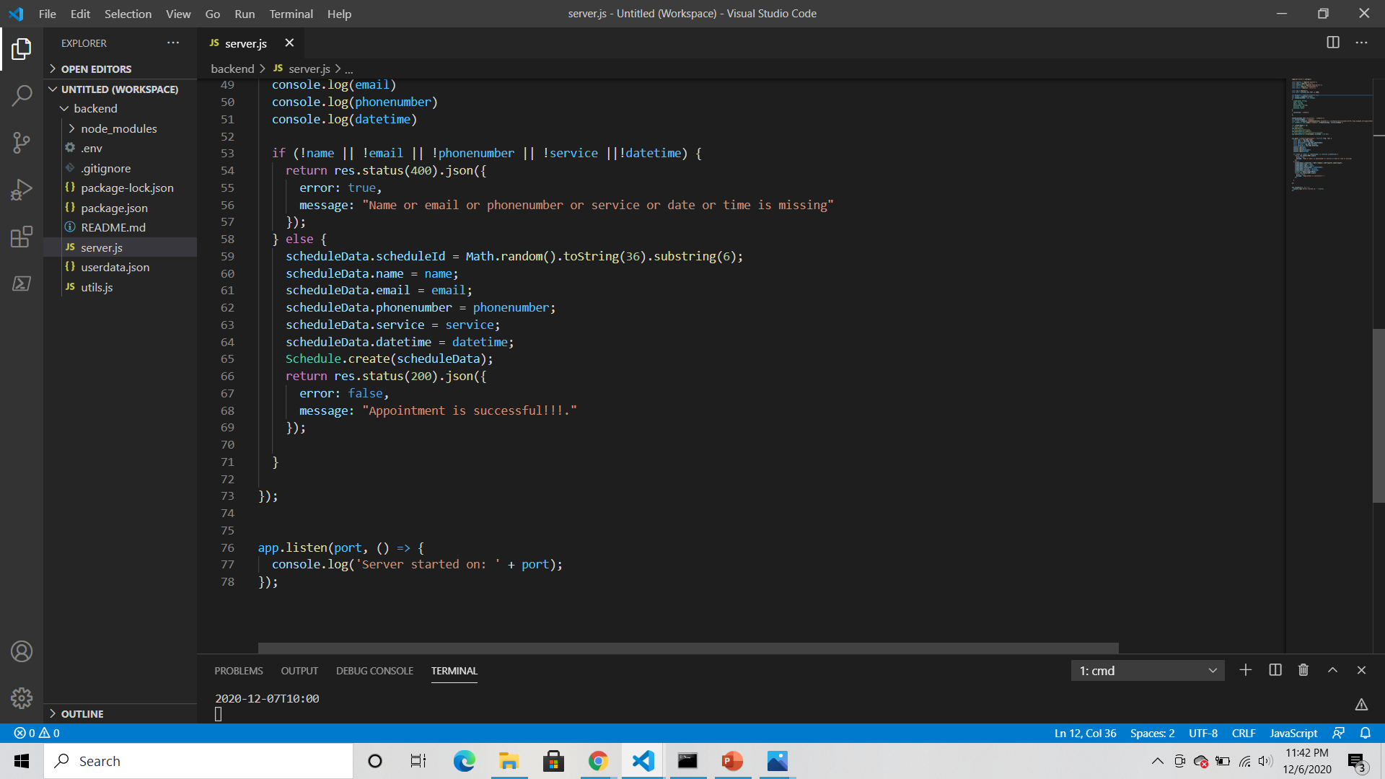
If any of the data is missing, it throws an error
If there are no errors, we populate scheduleData with the data received by the server and store it in a database using MongoDB
Once the data is submitted successfully, an alert box confirms the booking and redirects us to the home page

Slide 22
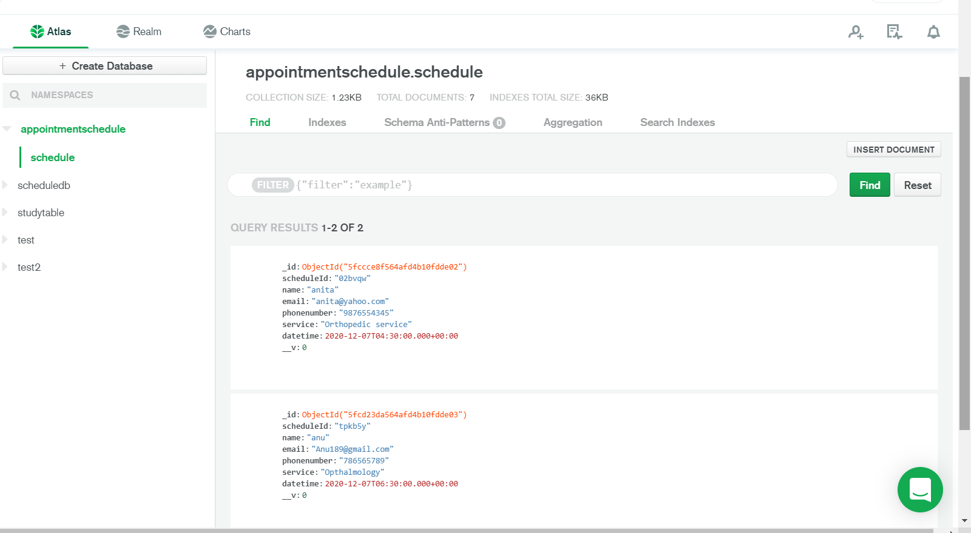
Database

Slide 23
Member Contributions
Front-end: Aishwarya
Back-end: Anusha
Database: Anusha

